Slide 1
An Introduction to Neural Networks A machine learning & Cognitive Science technique 06/19/2015

Slide 2
What is Artificial Neural Network ?
It is a statistical learning model inspired by Biological neural networks.
They are used to estimate or approximate functions that can be depend on large numbers of inputs and are generally unknown.
It is represented as system of interconnect “neurons”.
It is configured for specific application, such as Pattern recognition & Data classification.
"...a computing system made up of a number of simple, highly interconnected processing elements, which process information by their dynamic state response to external inputs”.
- Dr. Robert Hecht-Nielsen

Slide 3
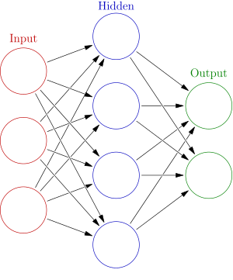
Basic Structural Representation

Slide 4
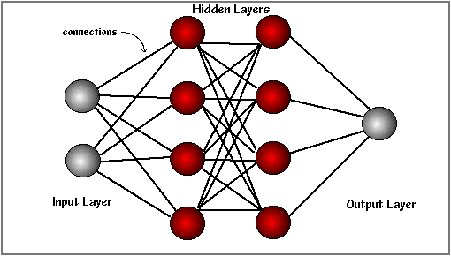
Basic Structural Representation ( Continued…. )

Slide 5
Why use Neural Networks ?

Slide 6
Why use Neural Networks ?
Adaptive learning: An ability to learn how to do tasks based on the data given for training or initial experience.
Self-Organisation: An ANN can create its own organisation or representation of the information it receives during learning time.
Real Time Operation: ANN computations may be carried out in parallel, and special hardware devices are being designed and manufactured which take advantage of this capability.
Fault Tolerance via Redundant Information Coding: Partial destruction of a network leads to the corresponding degradation of performance. However, some network capabilities may be retained even with major network damage.

Slide 7
Applications

Slide 8
Applications of Neural Networks
Sales Forecasting
Industrial process control
Customer research
Data validation
Risk management
Target marketing
Credit evaluation
Classification
In marketing: consumer spending pattern classification
In defence: radar and sonar image classification
In agriculture & fishing: fruit and catch grading
In medicine: ultrasound and electrocardiogram image classification, EEGs, medical diagnosis

Slide 9
Applications of Neural Networks(Continued…)
Recognition and identification
In general computing and telecommunications: speech, vision and handwriting recognition
In finance: signature verification and bank note verification
Assessment
In engineering: product inspection monitoring and control
In defence: target tracking
In security: motion detection, surveillance image analysis and fingerprint matching
Forecasting and prediction
In finance: foreign exchange rate and stock market forecasting
In agriculture: crop yield forecasting
In marketing: sales forecasting
In meteorology: weather prediction

Slide 10
Mathematical Representation

Slide 11
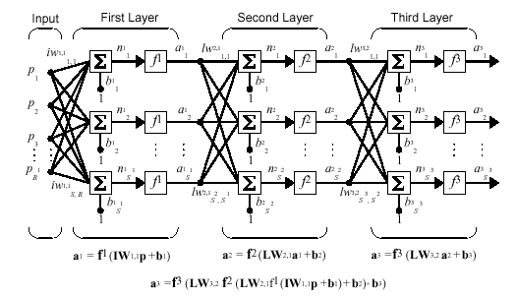
Architecture
The learning rule modifies the weights according to the input patterns that it is presented with. In a sense, ANNs learn by example as do their biological counterparts.
When the desired output are known we have supervised learning or learning with a teacher.

Slide 12
Delta Rule
The delta rule is often utilized by the most common class of ANNs called backpropagational neural networks.
When a neural network is initially presented with a pattern it makes a random guess as to what it might be. It then sees how far its answer was from the actual one and makes an appropriate adjustment to its connection weights.

Slide 13
Task management

Slide 14
How Neural Networks learns a task & Issues to be discussed
- Initializing the weights.
- Use of a learning algorithm.
- Set of training examples.
- Encode the examples as inputs.
- Convert output into meaningful results.

Slide 15
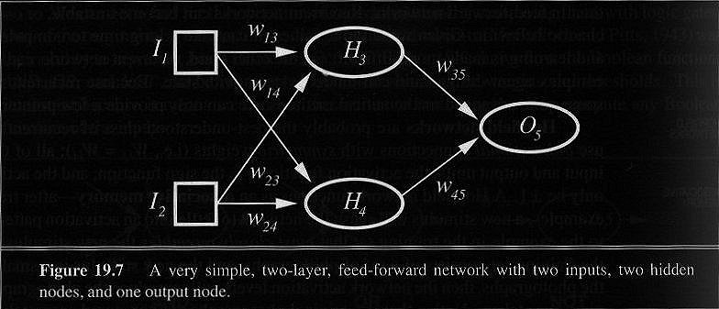
Neural Network Example

Slide 16
Computational parameters

Slide 17
Simple Computations in this network
- There are 2 types of components: Linear and Non-linear.
- Linear: Input function
- calculate weighted sum of all inputs.
- Non-linear: Activation function
- transform sum into activation level.

Slide 18


Calculations
Input function:
Activation function g:

Slide 19
Activation Functions
- Use different functions to obtain different models.
- 3 most common choices :
1) Step function
2) Sign function
3) Sigmoid function
- An output of 1 represents firing of a neuron down the axon.

Slide 20
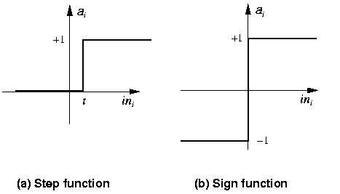
Step Function Perceptrons

Slide 21
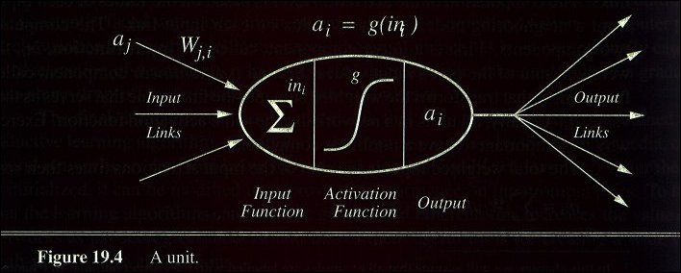
A Computing Unit
Now in more detail but for a particular model only

Slide 22
Design Considerations

Slide 23
Defining Neurons
What transfer function should be used?
How many inputs does the network need?
How many hidden layers does the network need?
How many hidden neurons per hidden layer?
How many outputs should the network have?

Slide 25
Slide separator

